Slide 1
Effects of Media on the Cryptocurrency Market
Presenters: Thu Nguyen, Amanda Graves, Carol George, & Jennifer Pham

Slide 2
Bitcoin Pizza Day!
On May 22nd, 2010, a Florida programmer and member of BitcoinTalk forum offered to pay 10,000 Bitcoins for anyone who would deliver him pizza.
An individual in the U.K. took him up on the offer, ordered two pizzas from Papa John’s for $25, delivered it and received 10,000 bitcoins in exchange.
This transaction posted on BitcoinTalk is famously referred to as the first ”real” bitcoin sale and has demonstrated how effective social media can be as a marketing platform.

Slide 3
Objective
The objective of our project is to observe and identify trends within the cryptocurrency world.
By analyzing historical and current data from various social API sources to identify potential factors influencing the price of cryptocurrencies.
Cryptocurrency relationships between social media are examined.

Slide 4
Media Influences on Cryptomarket
Does the frequency of subscribers on a Subreddit have an effect on the price of cryptocurrencies?
Is there a correlation between tweet polarity and cryptocurrency price?

Slide 5
Tools
Python Libraries
Vader
Got3
Matplotlib
Praw
Seaborn
Plotly
Pandas
Numpy
Statsmodels
Wordcloud
Data Sources
Twitter
Reddit
Kaggle
Cryptocompare

Slide 6
But wait, what is a cryptocurrency?
a digital or virtual currency that uses cryptography for security
Advantages:
difficult to counterfeit because of security feature
not issued by any central authority, rendering it theoretically immune to government interference or manipulation
easier to transfer and minimizes processing fees
Disadvantages:
can be wiped out by a computer crash if a backup copy of holdings do not exist
exchange rate can fluctuate widely since prices are based on supply and demand
not prone to hacking
Notes:
https://www.investopedia.com/terms/c/cryptocurrency.asp

Slide 7
How it works
Blockchain
Ledger
Request Transaction includes private and public key
Miners are powerful computers that compete to get verified blocks added to the chain
Once verified, the block is added to the chain and ledger is updated
Buyer – Seller transaction is complete. Wallets updated
CRYPTOCURRENCY TERMS:
Mining- running algorithms to confirm/verify transactions that happen on cryptocurrency networks.
Miners receive a fixed reward i.e. Bitcoins for every transaction verified. This is how new bitcoins are generated.
Blockchain – digital ledger in which cryptocurrency transactions are recorded chronologically and publicly
- Every time information is accessed and updated, the change is recorded and verified, then sealed off by encryption, unable to be edited again
Wallet- software program where cryptocurrencies are stored

Slide 8
Top 10 Cryptocurrencies (2/1/18)
Bitcoin (BTC)
Ethereum (ETH)
Ripple (XRP)
Bitcoin Cash (BCH)
Cardano (ADA)
Litecoin (LTC)
Stellar (XLM)
NEO (NEO)
EOS (EOS)
NEM (NEM)
Notes:
https://coinmarketcap.com

Slide 9
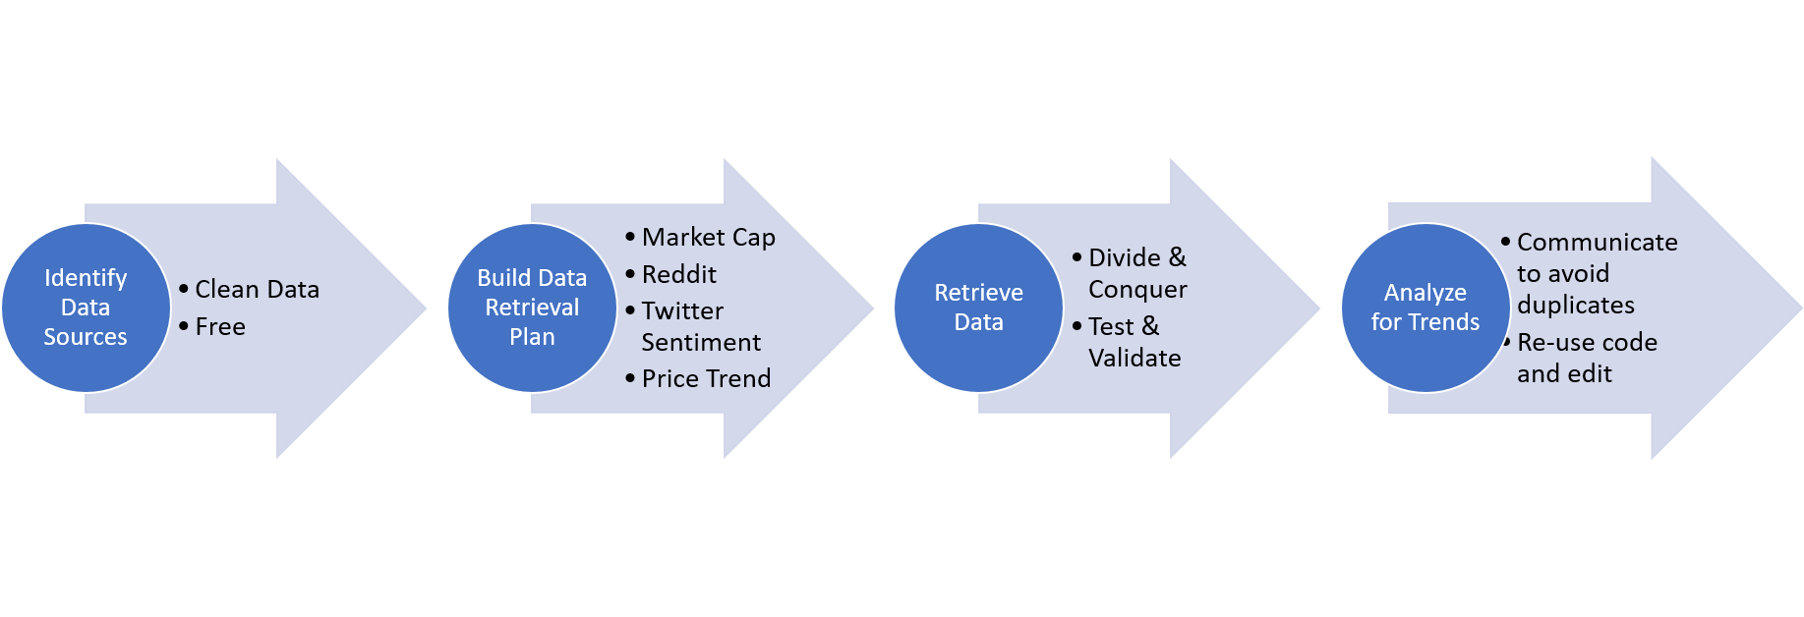
Data Clean-Up
& Exploration
Notes:
struggles
Being blocked from twitter
Not copying the same date
API sources cost money
Unable to gain follower history of social media accounts

Slide 10
Data Analyses

Slide 11
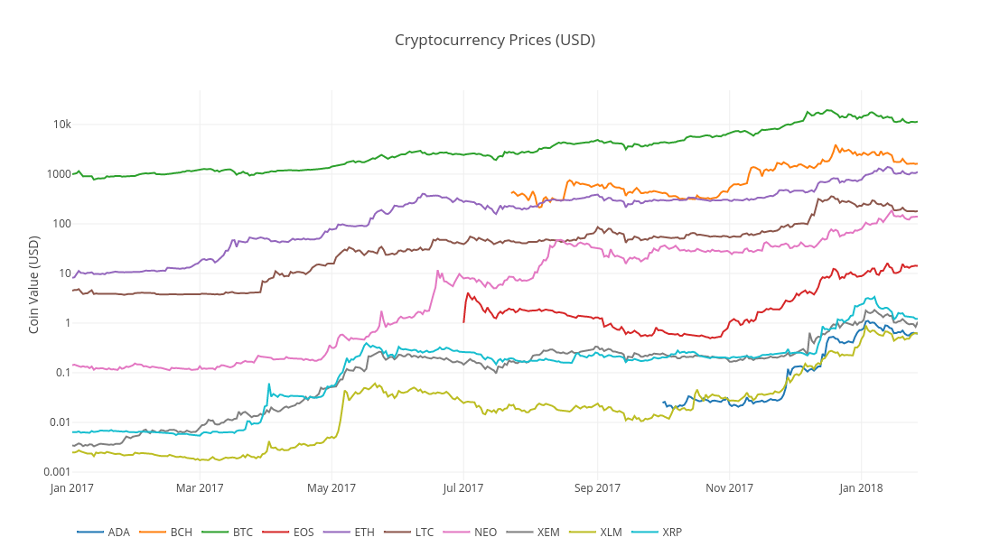
Coin values 01/17-01/18

Slide 12
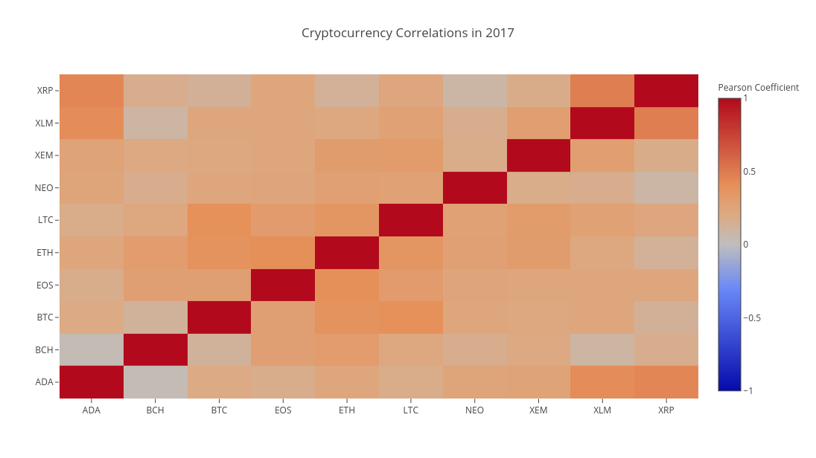
Heat correlation map for coins

Slide 13
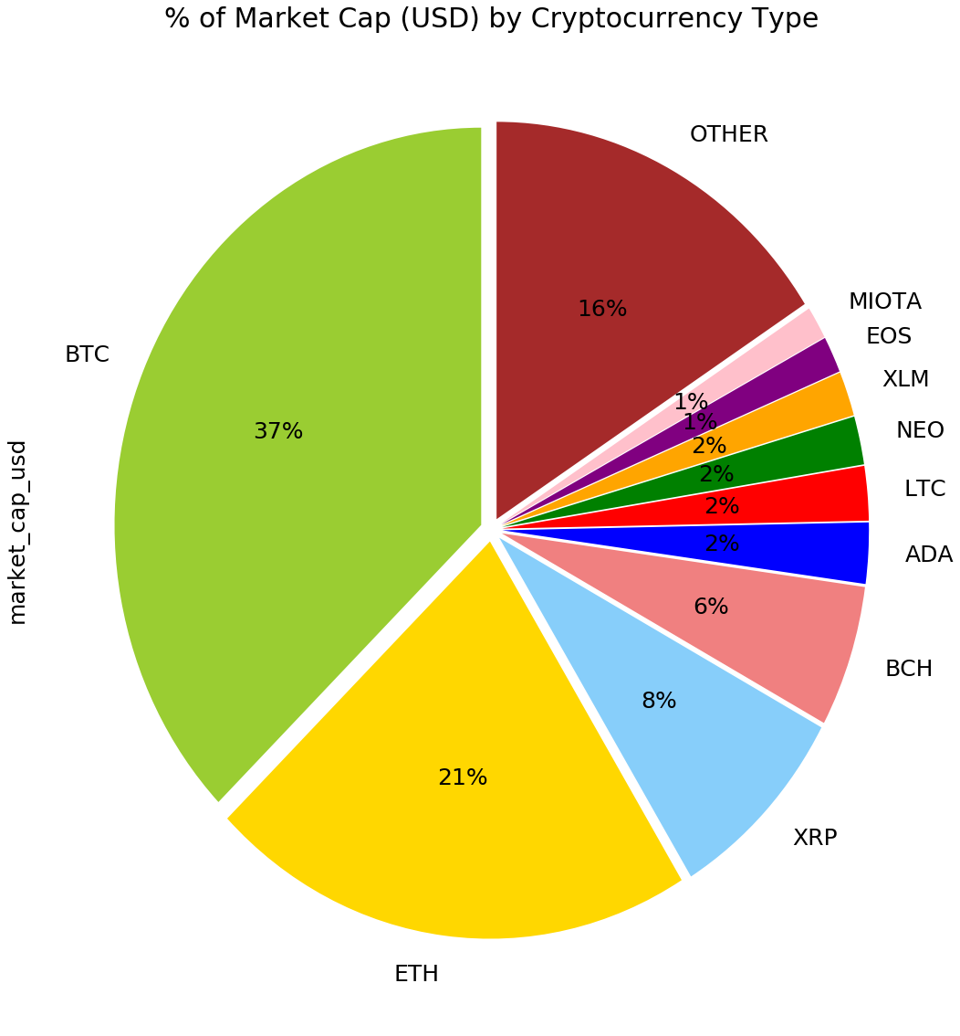
Coins vs. the total market cap

Slide 14
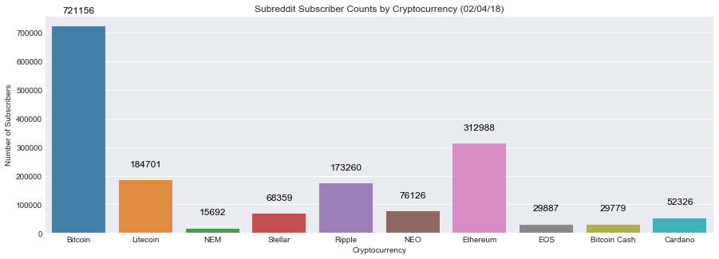
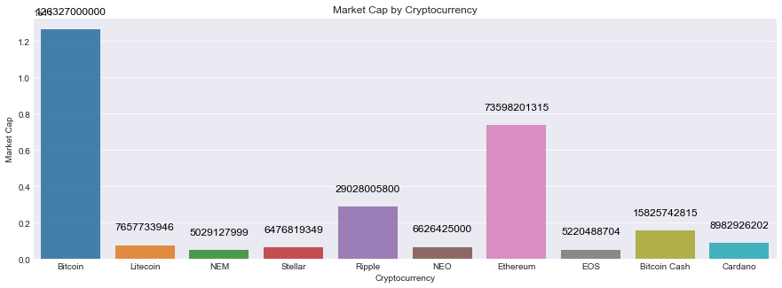
Subreddit subscribers vs. top ten coins
Market Cap vs. top ten coins

Slide 15
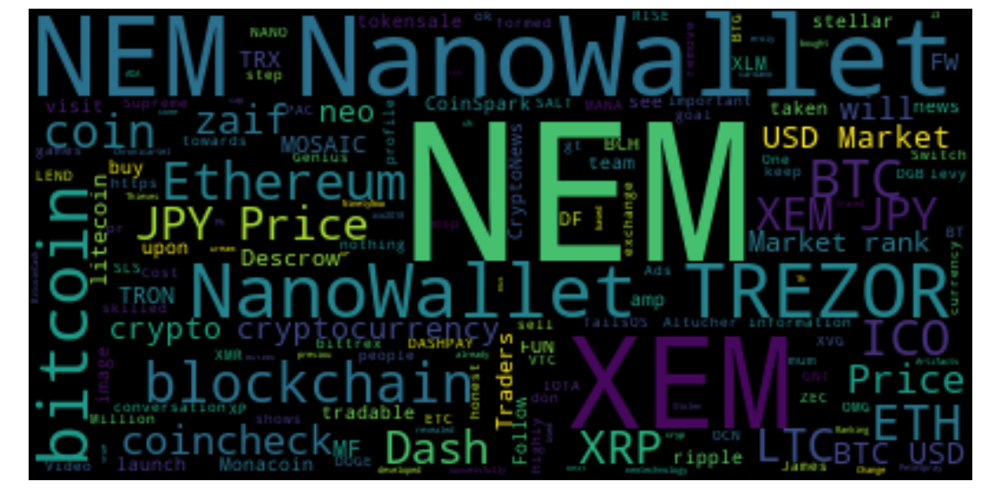
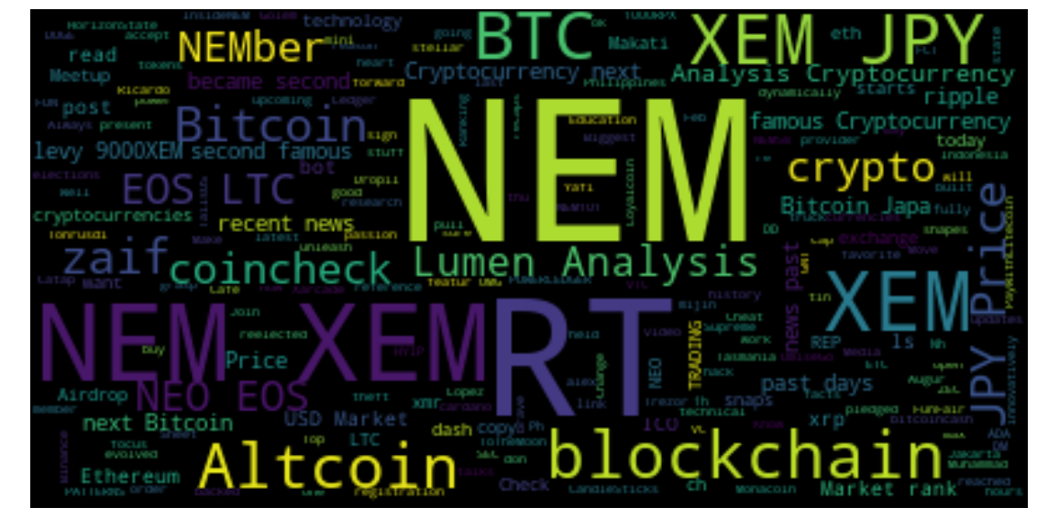
Saturday, February 3, 2018
Word Cloud
Tuesday, February 6, 2018

Slide 16
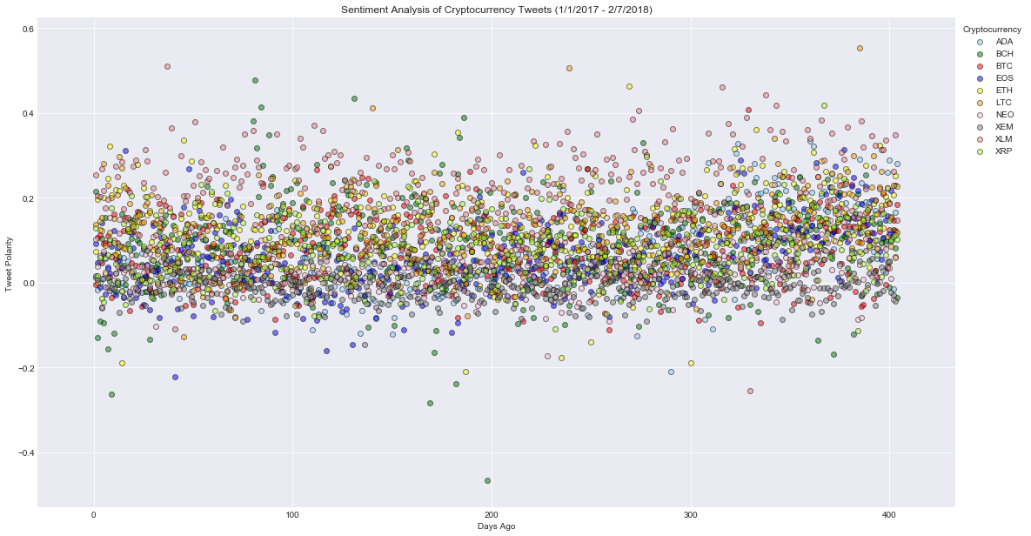
Sentiment analysis of coins

Slide 17
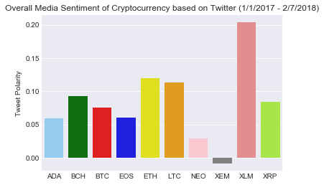
Overall Tweet polarity of coins on Twitter

Slide 18
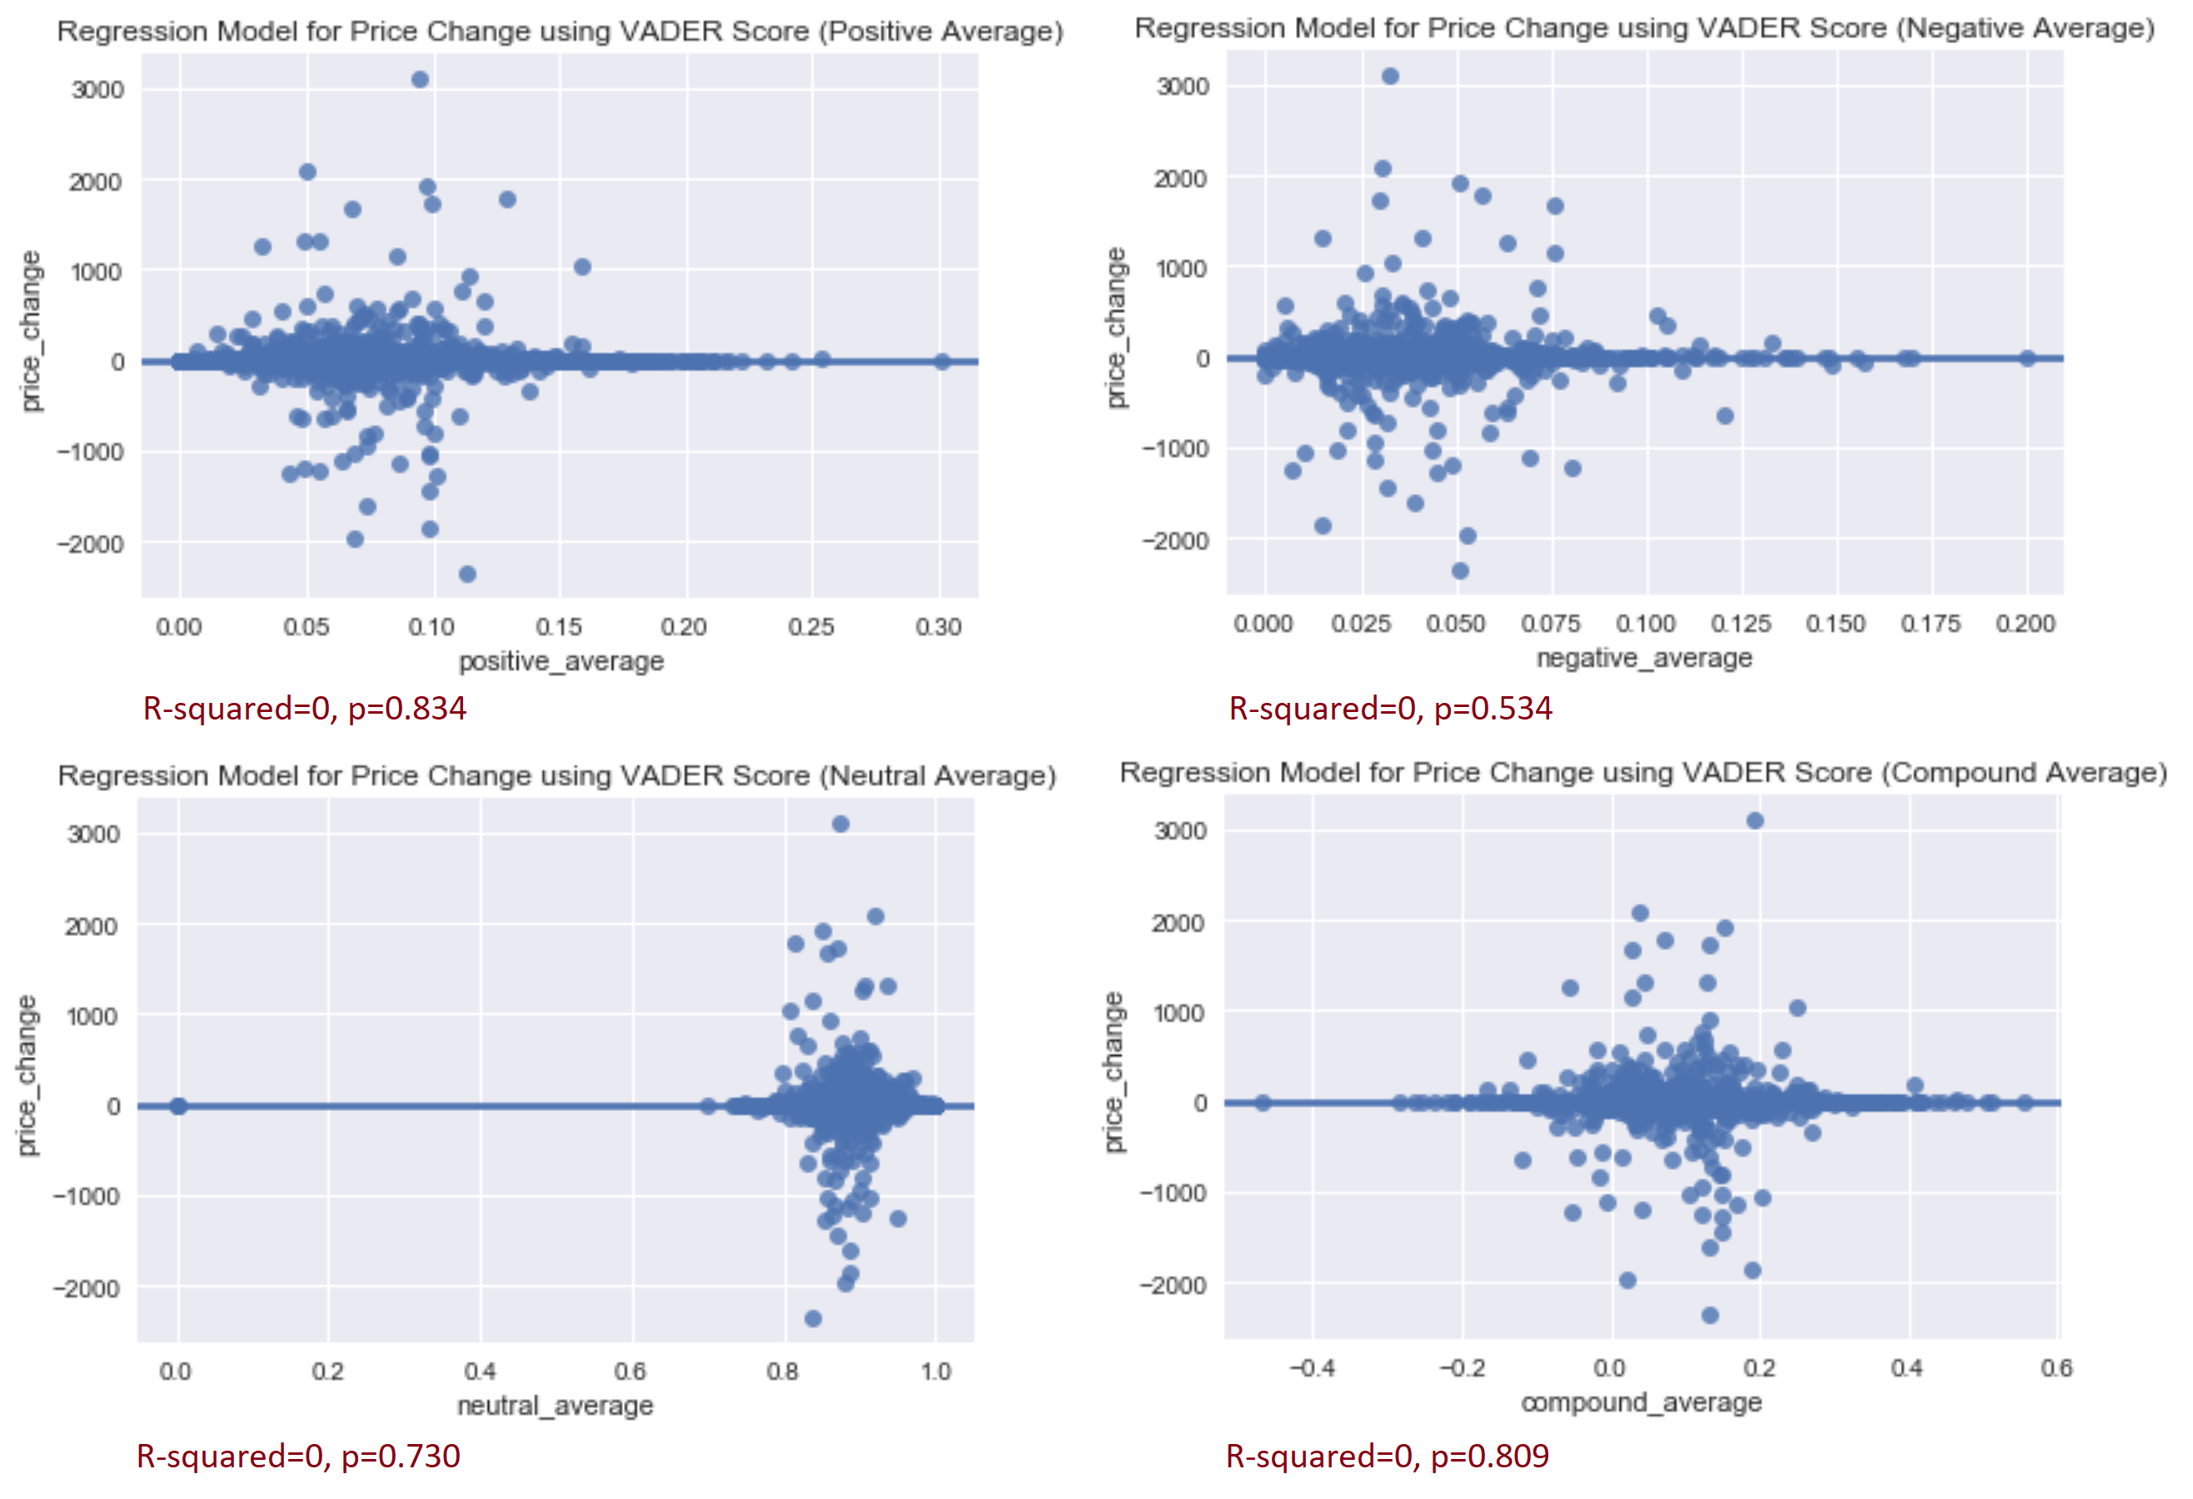
Regression model for price
change

Slide 19
Discussion/Post Mortem
Difficulties encountered
Possible ideas for future cryptocurrency data analyses
Track over a longer period of time
Use sources that require payment
Pay more attention to certain dates
Notes:
We narrowed our scope to fit our time frame and the access we had to resources.
If we had more time
Analyze certain dates (FB cryptocurrency ads, China CC ban)

Slide 20
Questions?

